Slide 1

Module 0
Python Programming
Notes:
Guidelines
Use section headers to chunk content in your presentation.
Use the same style of section header throughout your presentation.
Keep your title to no more than 2 lines.

Slide 2

Python Basics
Built-in and Imported Functions
Notes:
Guidelines
Use a title slide at the beginning of your presentation. There are 9 variations of title slides to choose from.
If you will have a series of slideshows, we recommend using the same style of title slide for each presentation.
Keep your title to no more than 2 lines.
Do not change the font style or font size of the title or subtitle.

Slide 3
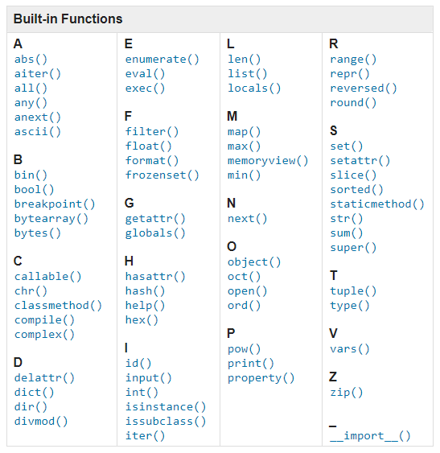
Built-in Functions
These are functions that are always available

Slide 4
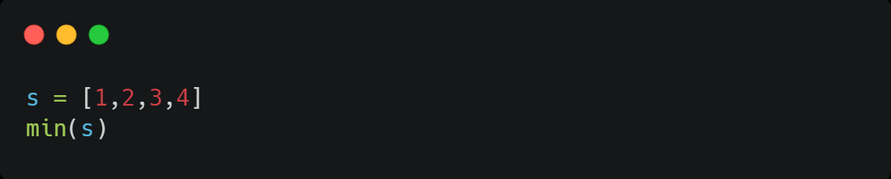

Examples of Built-in Functions
1
4

Slide 5
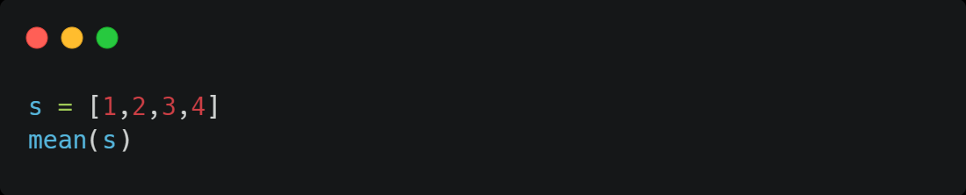
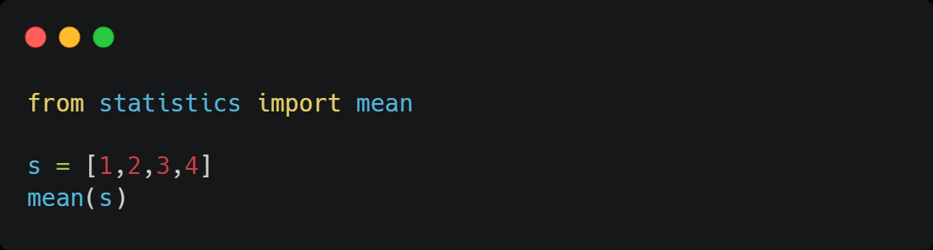
Imported Functions
These are functions that are imported from modules
To use, we need to import them
NameError: name 'mean' is not defined
2.5

Slide 6
Python Basics
Modules
Notes:
Guidelines
Use a title slide at the beginning of your presentation. There are 9 variations of title slides to choose from.
If you will have a series of slideshows, we recommend using the same style of title slide for each presentation.
Keep your title to no more than 2 lines.
Do not change the font style or font size of the title or subtitle.

Slide 7
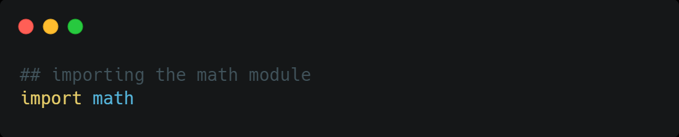
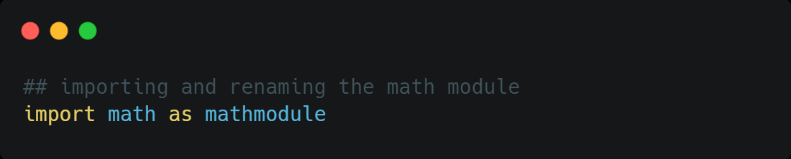
Modules
A module is a data type that contains multiple functions or methods meant to solve specific problems.
Aliasing

Slide 8
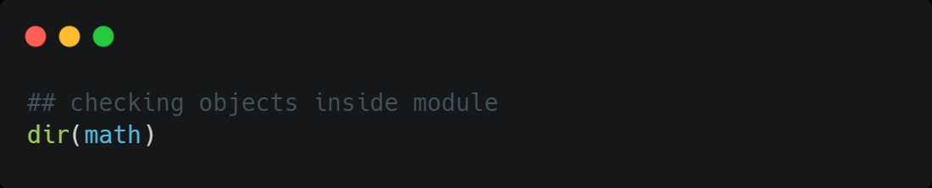
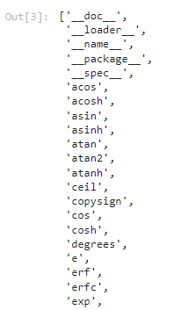
Modules
Attribute: math.e
Function: math.exp(x)

Slide 9
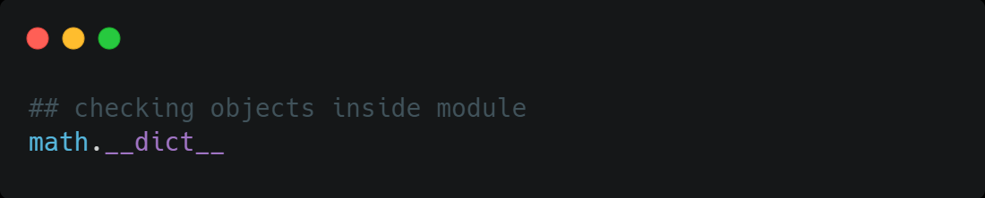
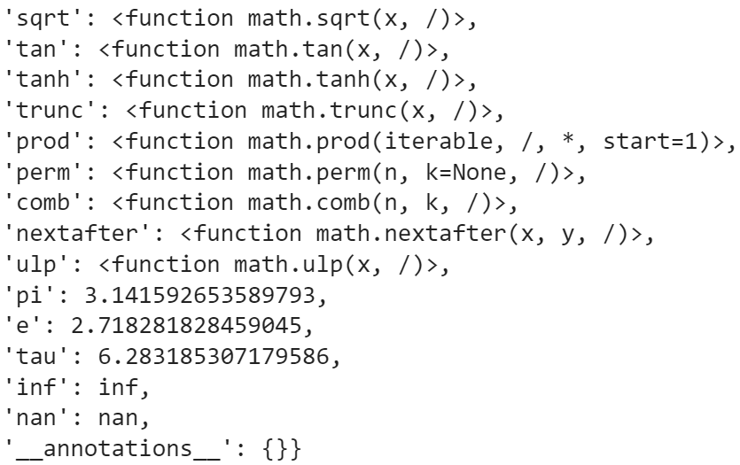
Modules

Slide 10
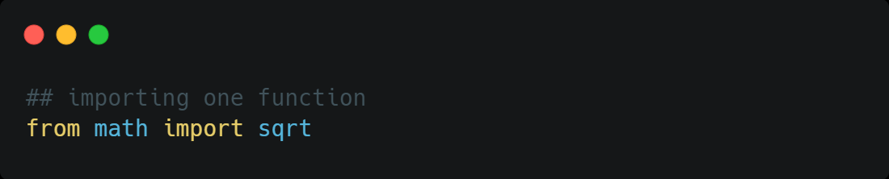
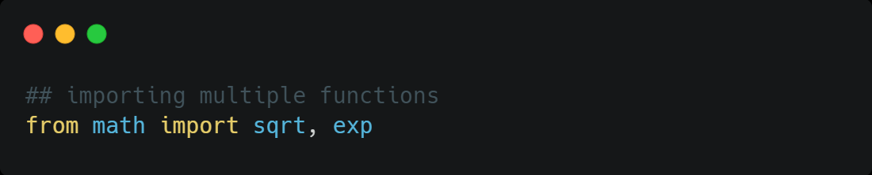

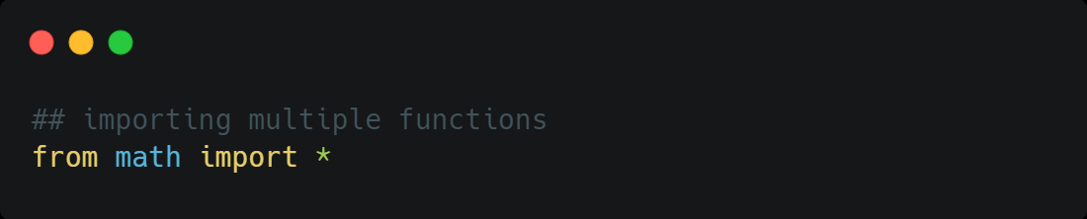
Importing from Modules
sqrt(9)
sqrt(9)
exp(2)
math.sqrt(9)
math.cos(1)
sqrt(9)
cos(1)

Slide 11
Python Basics
User-Defined Functions
Notes:
Guidelines
Use a title slide at the beginning of your presentation. There are 9 variations of title slides to choose from.
If you will have a series of slideshows, we recommend using the same style of title slide for each presentation.
Keep your title to no more than 2 lines.
Do not change the font style or font size of the title or subtitle.

Slide 12
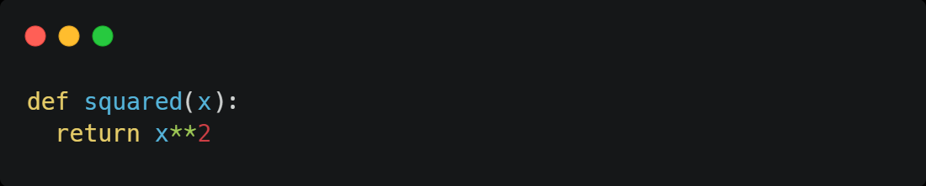
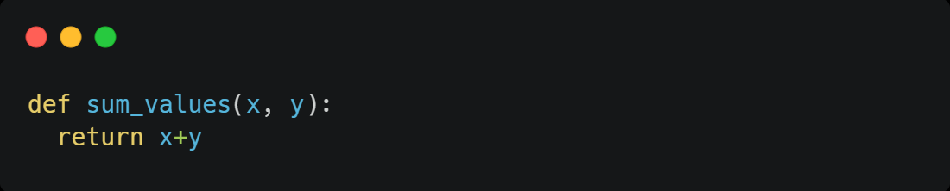
User-Defined Functions
Used to solve user-specific problems
Begins with the keyword def followed by the identifier name and :
The body of the function can contain multiple lines
Use the return keywork if needed.

Slide 13
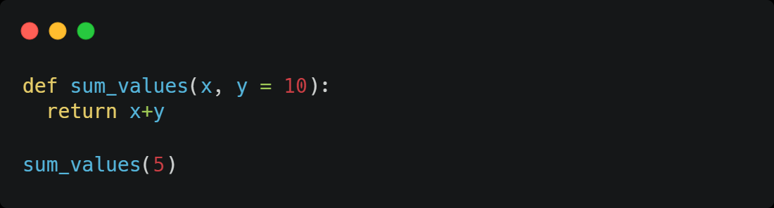
Default Values
Used in case parameter is missing
15

Slide 14
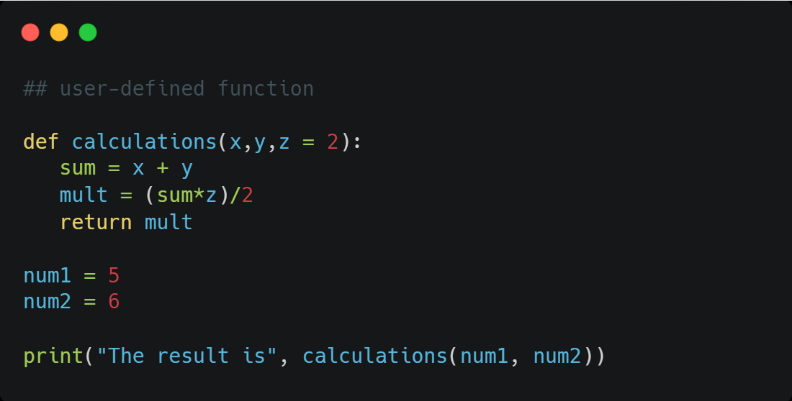
Power of User-Defined Functions
Can contain multiple lines of code
The result is 11.0
15

Slide 15
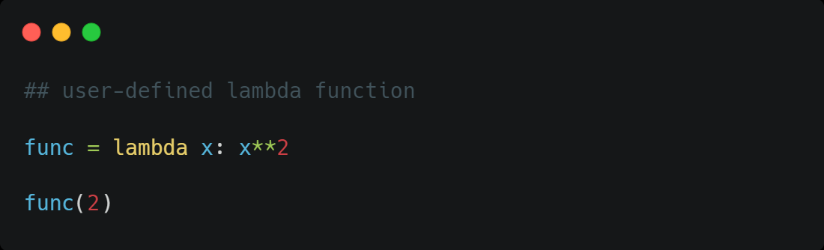
Lambda Functions
Generally used for short 1-line functions
4
15

